Slide 1
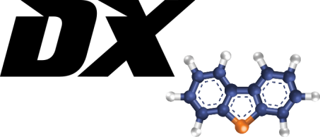
6th European Middle Distillates Conference
January 26 – 27, 2016
Direct Extraction (DX) Technology
Middle Distillate Desulfurization

Slide 2
The Importance of Middle Distillate Desulfurization
WHY DESULFURIZATION?
Increase Marketability
Higher Fuel Value
Expand Markets
High Value Sulfur By-Products

Slide 3
New Technology
Why the need for new technology on Desulfurization?
Complementary and alternative to conventional desulfurization technology:
Simpler and less expensive DX process
Lower operating costs
More dependable and cost competitive Desulfurization Process based on simple packbed adsorption process
Debottleneck existing plants
Benefit of New Desulfurization Technology
To offset profit loss

Slide 4
Flow Sheet

Slide 5
DX Design
Packaged skid-mounted equipment
Standard design and quick delivery
Various standard sizes
- 500 to 20,000 BPD modules
“Plug & Play”

Slide 6
DX Roles

Slide 7
DX Roles

Slide 8
DX Roles

Slide 9
Mass Balance

Slide 10
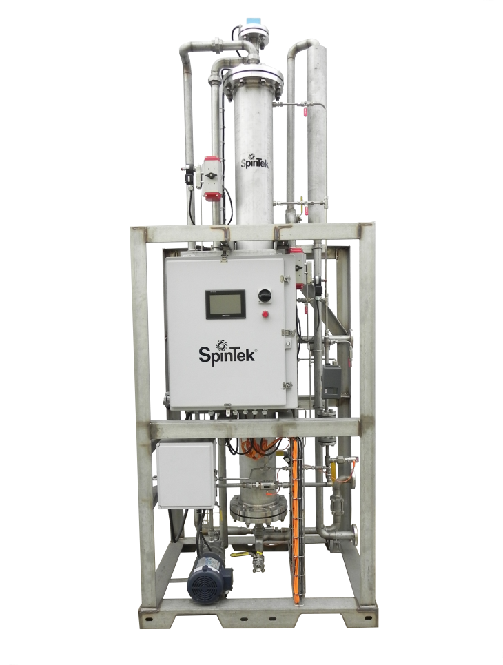
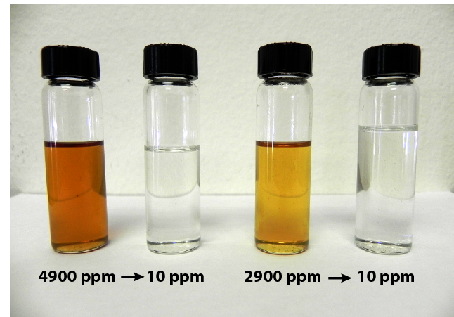
Operational Results
DXs Technology on Diesel
with 4900 ppm & 2900 ppm Sulfur
Full scale pilot plant

Slide 11
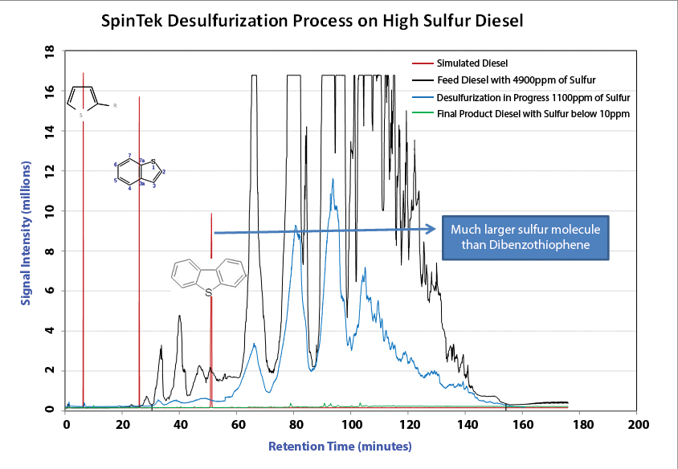
OrganoSulfur Markers
Test Results
Graph illustrates the DXs process in untreated (non-oxidized) diesel from 4900 pp to 10 ppm.
DXs process removes the same species of organosulfur compounds from the highly concentrated 4900 ppm sulfur diesel to the same extent as from the less concentrated 300 ppm sulfur diesel

Slide 12
Economic Analysis on Current Technologies
Operating Costs of HDS, ODS and DX
Cost of | Hydro Desulfurization | Oxidative Desulfurization | Direct Extraction
Pressure and Temperature | High | Low | Low
Catalyst / Adsorbent | Moderate | High | Moderate
Maintenance | High | High | Low
Equipment | High | High | Moderate
Safety Management | High | High | Low

Slide 13
Cost Analysis per 30,000 BPD*
 | Hydro Desulfurization | Oxidative Desulfurization | Direct Extraction
Capital Cost | US $ 24m | US $ 21m | US $10m
Hydrogen | US $ 17.2m/year | N/A | N/A
Peroxide | N/A | US $ 12.6m/year | N/A
Operating Cost | US $ 22.4m/year | US $ 20.8m/year | US $ 5.2m/year
Operating Cost per Barrel | $1.79 | $1.61 | $0.45
*https://web.anl.gov/PCS/acsfuel/preprint%20archive/Files/49_2_Philadelphia_10-04_1055.pdf

Slide 14
Summary
Packaged design for quick installation
Increase fuel value & marketability
Stand-alone processing or optimization of current HDS facilities
Lower operating cost
Debottleneck existing HDS capacity
Flexibility of Design to meet 500 ppm middle distillate or 10 PPM ULSD

Slide 15
Questions

